Slide 1
ICND-1 100-105 Training
By Jean A Casimir, Sr Network Engineer
And
Chief Development and Training Officer

Slide 2
Agenda
1- Networking Fundamentals
TCP/IP and OSI Model
Network topologies
Ethernet LANs
WANs
IPv4 and Routing
TCP/IP Transport/Applications

Slide 3
2- Ethernet LANs implementation
Ethernet LAN Switching
Switch Management
Switch interfaces configuration
Ethernet LAN designs
VLANs
Troubleshooting Ethernet LANs and VLANs

Slide 4
3- IPv4 and Subnetting
IPv4 Subnetting
Classful IPv4 Networks
Subnet Masks
Analyzing existing subnets

Slide 5
4- IPv4 Configurations
IPv4 addresses and Static Route configurations
RIPv2
DHCP
Variable-Length Subnet Mask (VLSM)
IPv4 troubleshooting

Slide 6
5- Access Control Lists and Network Address Translation
IPv4 ACLs
NAT
Troubleshooting ACLs
Troubleshooting NAT

Slide 7
6- Fundamentals of IPv6
IPv6 addressing and Subnetting
IPv6 Configurations for routers
IPv6 configurations for hosts
IPv6 routing

Slide 8
7- Device Management
Protocols Management
Security features
IOS management

Slide 9
Chapter -1 Networking Fundamentals
TCP/IP: Transmission Control Protocol/Internet Protocol
The suite of TCP/IP is known by several names.
Department of Defense(DOD) model,
Internet model
Originally started life as TCP in the 1970s
The predominant protocols in the stack

Slide 10
TCP/IP
It’s the foundation of all networking architecture.
OSI integrates all different vendors together within one networking model which was TCP/IP
Both OSI and TCP/IP became operational in the 1990s.
The OSI model owes its existence to the success of TCP/IP

Slide 11
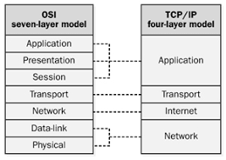
OSI and TCP/IP models
OSI model : Seven layers
TCP/IP model: Four layers

Slide 12
OSI and TCP/IP models cont’d
Application layer: Apps are located in this layer
Transport layer: Provides end-to-end data delivery between Applications
Internet layer: It manages the delivery of information from host to host.
Link layer: Transmits data to individual links

Slide 13
OSI and TCP/IP models cont’d
Data Link and Physical layer provide services to the layers above them.
When a device wants to send a packet to another device , that packet uses Data Link and Physical layers to deliver the packet to a router.
Encapsulation: It’the process of combining trailers and headers to create a new entity.
Every time each layer does its job, there is an encapsulation process that takes place.

Slide 14
OSI and TCP/IP models cont’d
Presentation layer:Establishes how information is presented for display or printing.
It presents data to the Application layer
It is responsible for translating data and formatting code.
Example: JPEG, MIDI, MPEG.
Session layer: It is responsible for setting up, managing and terminating communications
It controls dialog between devices.
Example: NFS,SQL, RPC

Slide 15
OSI and TCP/IP models cont’d
Network Layer: Also called layer 3, manages device addressing.
It determines the best way to move data.
Example: IP , RIP, OSPF, EIGRP, BGP
Data Link layer: Defines the protocols that control physical layer.
It handles error notification, flow control.
It ensures data is delivered to the proper device on a LAN.
It formats the messages into pieces called frames

Slide 16
TCP/IP Cont’d
Data sent from application layer is divided into segments appropriately sized for the network.
Transmission Control Protocol (TCP) and User Datagram Protocol(UDP)
Are the chief protocols at transport layer.
TCP provides reliable service by being connection-oriented with error detection and correction.
UDP is a simple, unreliable transport service.
It is connectionless. Delivery is not assured.

Slide 17
TCP Connections(Three-Way-Handshake)
SOURCE
Destination
1- Syn------------------------→
2- Syn/Ack <------------------
3- ACK ----------------------→

Slide 18
Five Steps TCP/IP Data Delivery process
Encapsulation the application data with the specified application layer. Example: httP
Encapsulate the application sent within a Transport layer header. Example TCP or UDP
Encapsulate the Transport layer within a Network Layer header. Example IP address
Encapsulate the information within the Network Layer.
Proceed with transmission of data. This is the encoding of physical layer into the medium.

Slide 19
Review Questions on TCP/IP
1- What is the definition of Encapsulation and De-Encapsulation?
2- What is a Network Model
3- Define Application and Internet layers
4- What are the 5 steps process for data delivery?
5- How does Encapsulation work?
6- What are the 2 types of TCP/IP Networking models?
7- What is the difference between the 2 types of models
8- Name the five layers of the 2nd type of the TCP/IP.

Slide 20
Network Topology
Network topology is a visual depiction of a network arrangement.
A pattern in which devices are connected.
There are several types of topologies:
Bus ,Ring, Star, Mesh, Tree, Hybrid

Slide 21
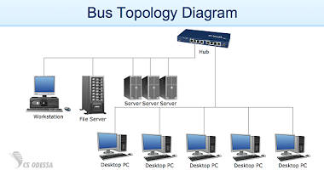
BUS Topology
Bus topology is a network architecture where all devices are connected to a single cable.
Example:

Slide 22
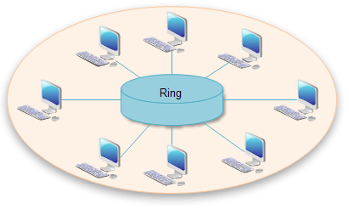
Ring topology
It’s a a network depiction in which each device is connected to another device.
All messages travel through ring in the same direction. Either clockwise or counterclockwise.

Slide 23
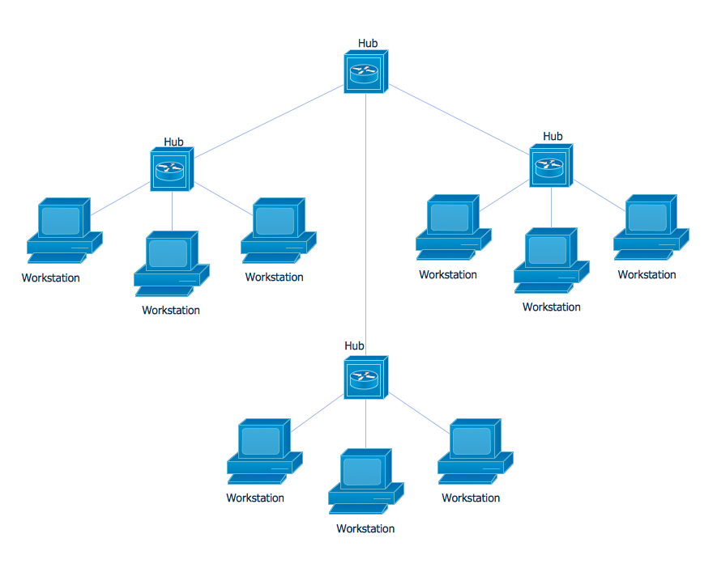
Star topology
All devices are connected to a central node or hub.

Slide 24
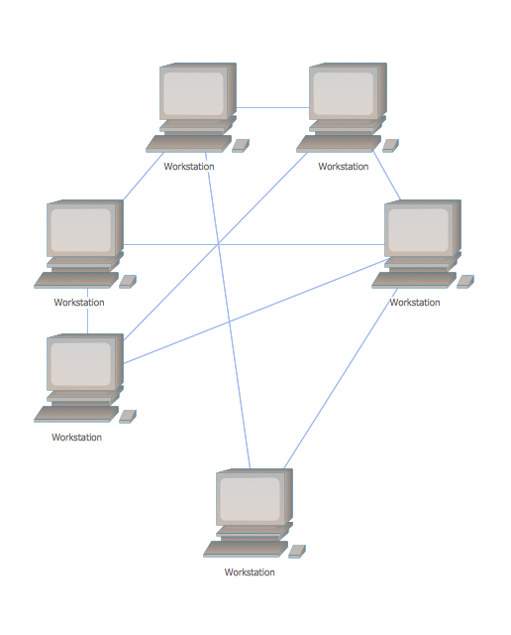
Mesh topology
A network architecture in which every device is connected to every other device.

Slide 25
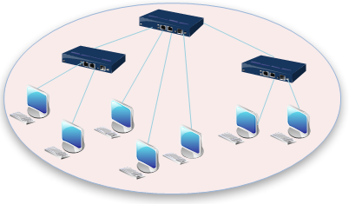
Tree topology
Also called hierarchical topology, tree topology integrates multiple star topologies together.
It should at least have 3 levels to the hierarchy.

Slide 26
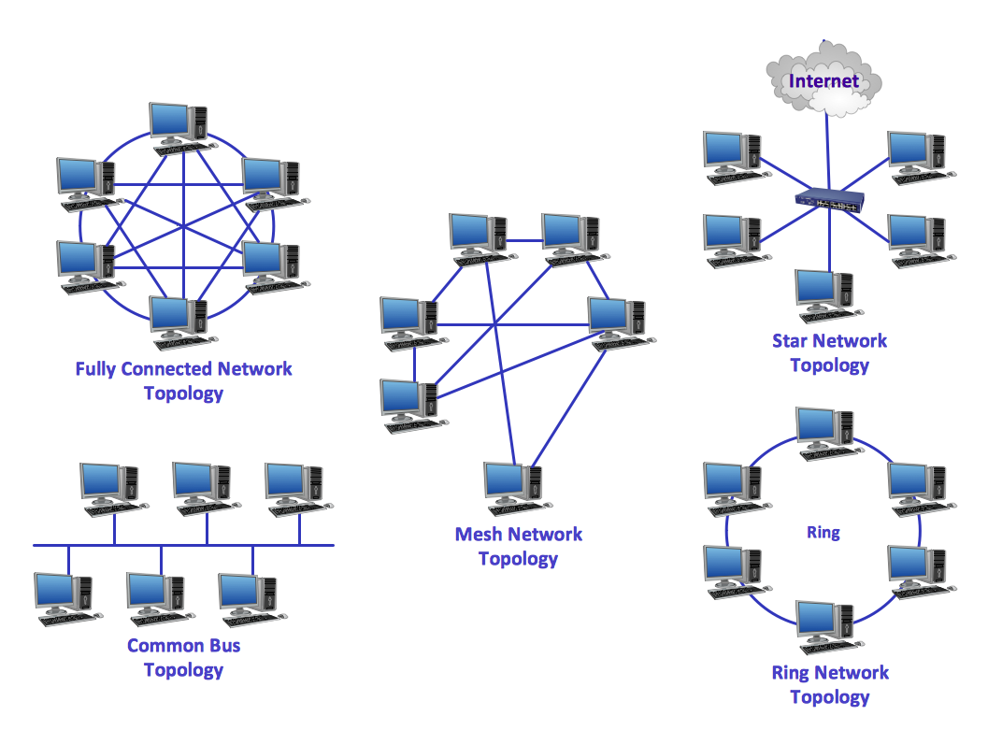
Hybrid Topology
It’s a combination of any 2 or more networks topologies.

Slide 27
Review Questions
What topology might be too expensive?
What topology consists of a number of devices through a single cable?
What is an hierarchical topology?
What is a hub-and-spoke topology?

Slide 28
Switching
Switches are layer 2 devices.
They break collision domains on every port.
Switches are hardware based
They make the switching decision based on MAC address.
Unlike routers , switches forward broadcast to all segments.
Think of a layer 2 switch as a multiport bridge because they both break up collision domains.

Slide 29
Ethernet LANs
Ethernet: Networking technology commonly used in LANs, MANs and WANs
Was invented in 1973 by Bob Metcalfe (Founder of 3Com)
In 1980, the Institute of Electrical and Electronics Engineers (IEEE) formed Project 802 to create international standards for LANs.

Slide 30
Ethernet LANs Cont’d
IEEE created several working groups to develop LAN standards:
IEEE 802.1: Overview, Architecture, Internetworking and Management
IEEE 802.2: Logical Link Control (LLC)
IEEE 802.3: CSMA/CD and MAC
IEEE 802.4: Token Bus and PHY
IEEE 802.5: Token Ring and PHY

Slide 31
Ethernet LANs Cont’d
Additional working groups have since been added to address other area of LAN technology
IEEE 802.3 standard: Published in 1985
It describes CSMA/CD which will delay transmitting.
IEEE 802.3 consists of standards for the following elements:
Transmission Media
MAC
Format of the Ethernet frames

Slide 32
Ethernet transmission fundamentals
Name | Speed | Cable | Connector | Distance
10BaseT | 10 | Shielded Twisted Pair | RJ45 | 100
10BaseFL | 10 | Multimode Fiber | ST | 2000
10Base5 | 10 | Thick Coax | AUI | 500
10Base2 | 10 | Thin Coax | BNC Barrel | 185
100BaseTX | 100 | Two pair Cat 5 UTP | RJ45 | 100
100BaseT4 | 100 | Four pair cat 3-5 UTP | RJ45 | 100
100BaseFX | 100 | Multimode Fiber | SC | 2000

Slide 33
Ethernet transmission Cont’d
Name | Speed | Cable | Connector | Distance
1000BaseT | 1000 | Twisted Pair | RJ45 | 100
1000BaseFX | 1000 | Fiber Optic | SC or ST | 2000

Slide 34
Ethernet cont’d
The IEEE standard develops the following Ethernet types:
10Base2: IEEE 802.3a. It’s a coax cable
10BaseT: IEEE 802.3i. UTP copper cable
100BaseTX/FX: IEEE 802.3u. Fast Ethernet UTP copper
1000Base-LX: IEEE 802.3z. Gigabit Ethernet SM Fiber
1000Base-T: IEEE 802.3ab. GbE Ethernet over Twisted Pair copper
10GbE: IEEE 802.3ae. 10GbE
* The word “base” means that Ethernet is baseband, that is, it is the only signal present in the wire. It doesn’t share it with non-Ethernet signaling.

Slide 35
Ethernet LANs Cont’d
There are 2 types of LANs:
Ethernet LAN: Also called wired LAN because it uses wires cables.
Wireless LAN: Also called Wi-Fi and uses radio waves as links.
WAN: Wide-Area Network is also a network computer technology.
WAN coverage is more far reaching.
What is the difference between LAN and WAN?

Slide 36
Ethernet Frame
Ethernet Frame Consists of ethernet header ,data, trailer
Transmitted data within the network is encapsulated in an Ethernet frame.
Ethernet frame is the IP packet being sent and received withing the LAN.
Ethernet frame consists of the following fields:
Preamble-
Start Frame Delimiter(SFD)
Destination address
Source address
Type
Data
Frame Check Sequence (FCS)

Slide 37
Ethernet frame
Preamble | Start of frame | Destination Address | Source Address | Type | Data | FCS

Slide 38
Ethernet frame
Preamble:
7 bytes long alternating pattern of 0s and 1s
It tells the receiver a new frame is arriving.
It is used for Synchronization
Start of Frame:
It’s a 1 byte field that indicates the start of an Ethernet frame.
Destination Address
It’s a 6 byte field that contains the MAC address of the recipient of the frame.

Slide 39
Ethernet frame cont’d
Source Address:
It’s the MAC on the sender of the frame.
5. Type:
IPv4 or IPv6 protocol
6- Data
Contains the user data of the frame that is being transmitted and is 46 to 1500 bytes long.

Slide 40
Ethernet Link types
Ethernet link: Ethernet cable that connects 2 devices
RJ-45 is the most common connector in an Ethernet environment.
RJ-45 contains 8 PIN positions
PINs connect 8 wires to the node.
RJ-45 Ethernet port is compatible with RJ-45 connector

Slide 41
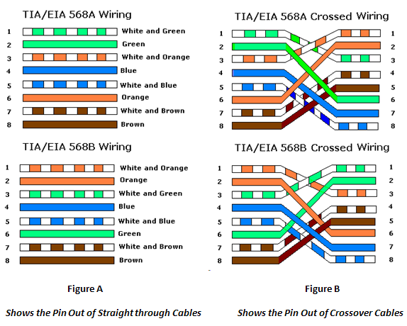
Straight-Through Cable
Straight-through cable is a twisted pair copper wire cable.
It uses RJ-45 connectors at each end and have the same pinout.
Example: A PC connection to an Ethernet switch.

Slide 42
Cross-over cable
It is used to connect 2 similar network devices
Example connection of 2 hubs or 2 PCs.
Refer to the diagram in the previous page for cross-over pinouts.

Slide 43
Review questions
What’s the difference between LAN and WAN?
What’s the 2 types of Ethernet cables?
What’s the difference between Ethernet LAN and Wireless LAN?
How can you define a cross-over cable?
What is an Ethernet link?
What is a straight-through cable?
What are the fields of an Ethernet frame?
What is a MAC address

Slide 44
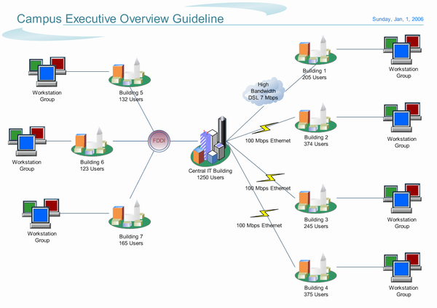
Wide Area Network ( WAN)
WAN is a technology that allows enterprises to connect offices that are located in multiple regions.
WANs are leased line that provide the networking service.
Leased lines are provided by Service Provider ( SP) such as the telecommunications companies
Example:

Slide 45
Ethernet WANs
Unlike Ethernet LANs that are used for Local-Area-Networks.
Ethernet WANs are used through longer distances.
The 1000Base-LX is a SMF Ethernet cable that can connect LANs at 5km distances.
The 1000Base-ZX can connect LANS at 70km distances.

Slide 46
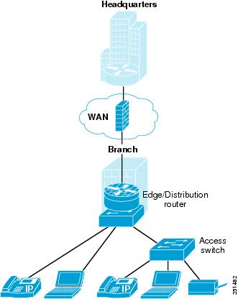
Ethernet WANs cont’d
Currently the Ethernet cables technology can be used to create WAN.
Internet Core consists of Ethernet LANs and Ethernet WANs interconnection
Internet Core connects all Service Providers (ISPs).
LANs connected to internet via cables or wireless technology are called Internet Access Links.

Slide 47
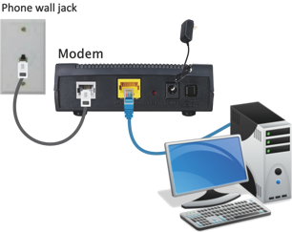
Ethernet WANs cont’d
Digital Subscriber Line (DSL)
DSL: a high speed WAN link that connects to internet via telephone lines
DSL WAN link is provided by ISP
Internet connection can be either through a regular modem, LAN, cable modem or DSL

Slide 48
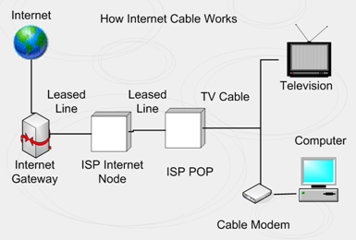
Ethernet WANs cont’d
Cable Internet:
It provides Internet access that uses the same infrastructure as DSL or cable television.
Here is an Example:

Slide 49
Review Questions:
What is the Internet Core?
Can you provide a diagram of DSL WAN links?
What is a lease line WAN?
What is the difference between LANs and WANs?
Difference between Ethernet WAN and Ethernet WAN link
Create a diagram of LAN to LAN WAN link over leased lines
Create a diagram of a basic Ethernet WAN link between 5 separate LAN networks.

Slide 50
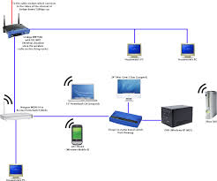
Wireless LAN
Ability to remain connected and mobile without wires.
Wireless IEEE802.11 standard has been ratified in 1997 for LAN/MAN
IEEE802.11 standard is the WLAN working group with LAN/MAN community.
Typical wireless network is an extension of LAN

Slide 51
Wireless LAN (WLAN) cont’d
The first WLAN had a data rate up to 2Mbps
It could go about 200–300 feet depending on the area
It was called simply 802.11.
The rates in use today are higher and are 11Mbps and 54Mbps;
These are called IEEE 802.11b and 802.11g/a, respectively.

Slide 52
Spread Spectrum Technology
Spread Spectrum is a coding technique for digital transmission.
It is a form of wireless communications in which the frequency of the transmitted signal is deliberately varied
It results in providing a much greater bandwidth.
Frequency: describes the number of waves that pass a fixed place in a given amount of time.
Bandwidth: Is the amount of information that can be carried through any communication medium.
Bandwidth is the capacity for sending and receiving data

Slide 53
Spread Spectrum Technology con’td
Spread spectrum is currently the most widely used transmission technique in WLAN.
There 2 different spreading techniques:
Frequency Hopping Spread Spectrum (FHSS): This is the process of jumping quickly from one frequency to another.
It splits the signal into separate parts.
Direct Sequence Spread Spectrum (DSSS): This technique reduces interference.
DSSS doesn’t split the signal into pieces.

Slide 54
DSS Channel Setup
11 total channels can be used for RF transmission in WLANs.
Each channel is 22 MHz wide.
All channels combined equal the entire spectrum that be used for 802.11 WLANs.
When designing WLANs, multiple channels become an issue when overlapping coverage is required.
When 2 APs have overlapping coverage, each of them must be using a different channel.

Slide 55
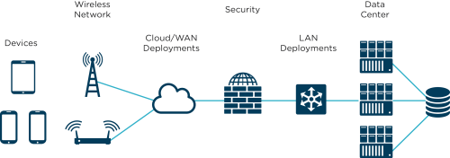
802.11 topologies
IEEE 802.11 standard supports the following three topology sets:
Basic Service Set (BSS) Network: It consists of at least one connected to wired network and a set of wireless end stations.

Slide 56
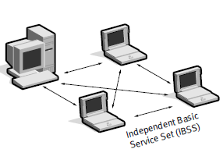
802.11 topologies cont’d
2. Independent Basic Service set (IBSS) Network:
IBSS is also referred to as an ad-hoc network.
IBSS topology sets consist of a number of wireless end stations that communicate directly with one another without AP.
Ad-hoc implementations are not connected to any network and cover a small area.

Slide 57
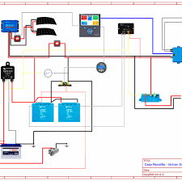
802.11 topologies cont’d
Extended Service Set (ESS) Networks:
ESS consists of overlapping BSS sets, called “cells”.
Cells are referred to as “distribution systems” (DS)
and are usually connected together by wired medium.
Most corporate WLANs require access to the wired LAN for services.
They operate in a BSS/ESS topology.

Slide 58
802.11 Services
There are nine IEEE802.11 services:
Four are station services (Authentication, de-authentication, data delivery and privacy)
Five are distribution services ( Association, re-association, disassociation , integration and distribution).

Slide 59
802.11 Services cont’d
1. Authentication service: It defines the identity of the wireless device.
Authentication can be configured against a list of MAC addresses.
A wireless device can authenticate itself to more than one AP.
2. De-authentication service: It uses to trear down a previously known station identity.
De-authentication is used when a wireless device is shutdown.
It frees up resources on the AP for other devices.
3. The privacy service: is used to protect the data in WLAN.
It protects the data with a feature called Wireless Equivalency Privacy (WEP)

Slide 60
802.11 Services cont’d
4. Association service: It handles the logical connections between devices.
It calculates the path that the DS takes to a wireless device.
Association service is used as soon as a device is connected to an AP.
5. Re-association service prevents wireless devices from losing network sessions.
6. Disassociation service is used to disconnect a session.
7. Integration service handles data translation from 802.11 frame format into the wired network frame format. And vice versa.It resides in the Aps.
8. Distribution service: used by Aps to determine whether to send a frame to another AP

Slide 61
802.11b
802.11b has been ratified in 1999.
It standardizes the physical layer support of two new speeds:5.5 Mbps and 11 Mbps.
Operates at 11 Mbps and the same features and service as 802.11 standard.
It allows data rates to be automatically adjusted in case of interference.
When devices move beyond 11 Mbps ops, the will transmit at lower speeds, falling back to 5.5, 2 and 1 Mbps

Slide 62
802.11a
Another extension of 802.11 standard.
It uses an encoding modulation technique called Orthogonal Frequency Division Multiplexing (OFDM:a major part of most wireless companies).
It operates at 5 GHZ and its speed is up to 54 Mbps
It cannot interoperate with 802.11b because they use 2 different frequencies.
802.11g: Offers a max of 54 Mbps using 2.4 GHZ spectrum.
It supports both speeds of 802.11a/b

Slide 63
Security Fundamentals for WLANs.
IEEE 802.11 provides three ways to secure WLANs:
Service Set Identifier (SSID): A sequence of alphanumeric that uniquely identifies a Wifi device.
It can be associated with one or more APs to create multiple segments.
MAC Address: AP can authenticate a wireless device based on a list of MAC addresses.
Encryption: WEP uses an encryption to encapsulate the 802.11 data frames.
*** VPNs are a form of encryption as well.

Slide 64
Extensible Authentication Protocol (EAP)
EAP provides authentication within PPP
EAP can define one or more request for peer-to-peer authentication.
EAP provides a flexible, link-layer security framework
EAP can support pre-packet authentication and integrity protection

Slide 65
Review questions:

Slide 66
IPv4 and Routing
IP Address:
A numeric identifier that is assigned to each host.
A software address (NOT Hardware address) that is uses for finding hosts on a LAN.
IP Routing:
A process of forwarding packets to hosts.
A process of transporting data from source to destination

Slide 67
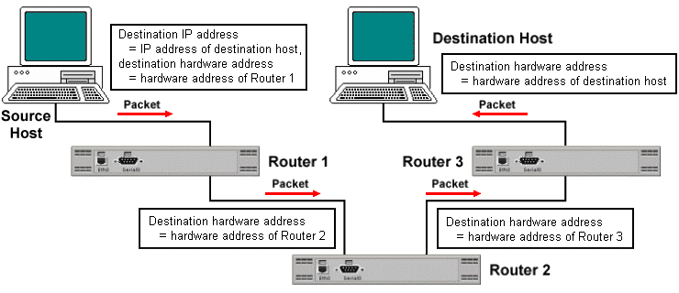
IPv4 and Routing cont’d
IP routing protocol:
A process for routers to communicate with each other
It determines the path that data follows from source to destination.
Example of Data transfer:

Slide 68
IPv4 and Routing cont’d
IPv4 :
Consists of 32 bits of information
These bits are divided into four sections
These sections are referred to as octets or bytes
IP address can be depicted using one of the three methods:
Dotte-Decimal Notation (DDN) as in 10.1.1.1
Binaray as in 10101100.00010000.00011110.00111000
Hexadecimal (hex) as in AC.10.1E.38

Slide 69
IPv4 Terminology:
The following are important terms to understand:
Bit: a bit is a one digit; either 1 or 0
Byte: a byte is 8 bits
Octet: An octet is made of 8 bits.
The terms byte and octet are completely interchangeable.
Network Address or IP Networks: It’s the designation used in routing to send packets to a remote network.
IP networks are groups of IP addresses within similar values.

Slide 70
IPv4 and Routing cont’d
IP address Classes: Class A- Class B and Class C
There are five classes of IP addresses.
Only three are used to assign unicast addresses to end devices.
There are billions of IP addresses in the IPv4 address space:
Class A:
The largest grouping of address with 126 IP networks assigned to it.
Each IP network in Class A hold 16 million IP addresses
Class A range is 1-126. ( 1.0.0.0 to 127.255.255.255)

Slide 71
IPv4 and Routing cont’d
Class B:
Class B range is 128-191 (128.0.0 to 191.255.255.255)
Each Class B IP networks contains more than 65,000 IP addresses for each network.
Class C:
Class C range is 192-233 (192.0.0.0 to 233.255.255.255)
Each Class C IP networks contains 256 (254) IP addresses.

Slide 72
Review Questions
What is an IP subnet? What is its value?
Create a diagram of a basic IPv4 routing process
What are the classes of IP networks?
Define an IP packet
Define IP forwarding
What is the number of IP addresses available to Class A and B?
Define IPv4 addressing. What is its significance?

Slide 73
Switches and Ethernet LANs
Ethernet switch: It’s responsible for moving from one port to another.
Hub: A central point where devices send frames to communicate with each other.
Issues with HUB:
It sends electrical signal to all ports
Collision of multiple devices
Devices have to take turns before sending signals.
Hubs share bandwidth, but switches don’t

Slide 74
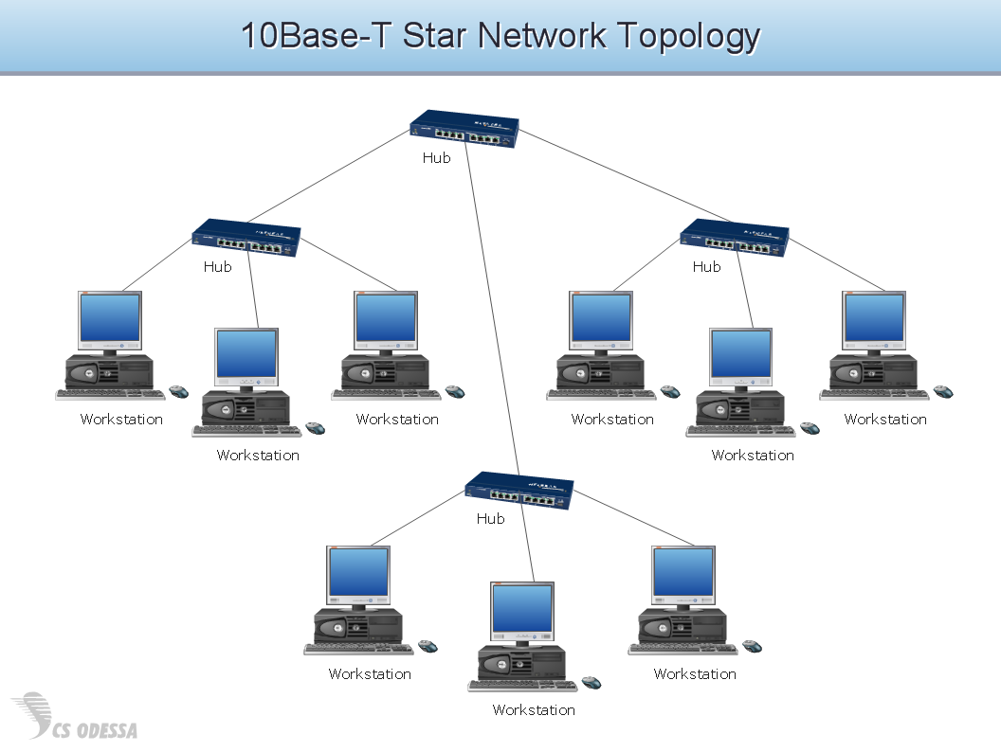
Switches and Ethernet LANs cont’d
Hub Example:

Slide 75
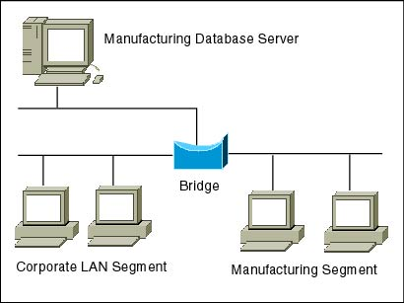
Switches and Ethernet LANs cont’d
Bridge:
A software based networking device that connects one LAN to another that uses the same protocol
A networking device that connects two separate networks.
Bridge breaks up collision domains

Slide 76
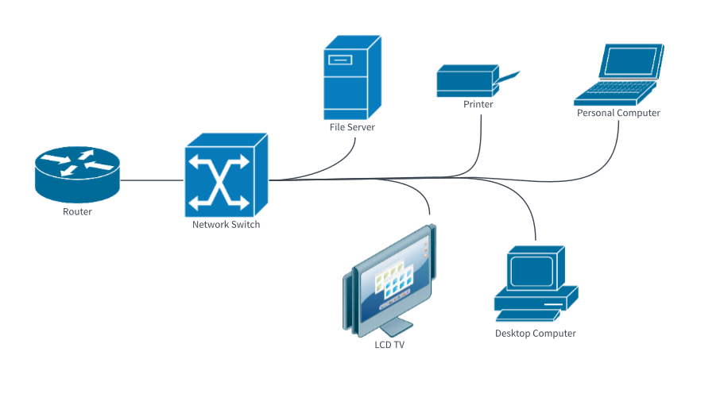
Switches and Ethernet LANs cont’d
LAN Switch:
Works like Bridges but it is more efficient and faster.
It’s main purpose is to make LANs work better.
It forwards frames from one port to another
It learns, stores and reads and forwards frames based on MAC address

Slide 77
Switches and Ethernet LANs cont’d
In the diagram below, computer B sent a frame with the destination address AAA.
LAN switch receives the frame
Looks for the location of MAC address AAA
Address table tells the switch the MAC address is located via output Fa2
It then moves the frames towards output Fa2. An example in the next slide

Slide 78
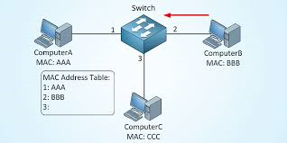
Switches and Ethernet LANs cont’d
Example of the LAN Switch MAC Address table:

Slide 79
Switches and Ethernet LANs cont’d
A LAN switch identifies new MAC addresses
It’s storing it in the MAC address table
It listens to every incoming frame
Checks its MAC address
If MAC address is not recorded yet in the MAC address table, it records it

Slide 80
Switches and Ethernet LANs cont’d
Flooding frames:
When a switch receives a frame with a MAC address that is not in the MAC table:
It sends the frame to all the outgoing interfaces.
It floods (broadcast) the outgoing interfaces with frame.
It allows the switch to record new MAC addresses in the its MAC table.

Slide 81
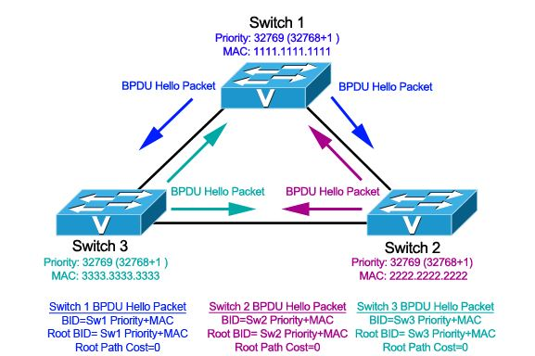
Spanning Tree Protocol (STP)
Spanning Tree Protocol (STP) is a feature a LAN switches.
It allows switches to block certain ports to avoid loop
This feature runs on bridges and switches.
The specification for STP is IEEE 802.1D.
Its main purpose is to ensure that you do not create loops when you have redundant paths in your network.

Slide 82
LAN Switch Modes
Switch modes: Decide how a frame is handled when it’s received on a switch port.
Latency: The time it takes for a frame to be sent out a port once the switch receives it.
Three types of switching modes:
Cut-through
Fragment Free
Store-and-forward

Slide 83
LAN Switch Modes cont’d
Cut-Through:
In this mode the switch copies only the DA onto its buffers
It reduces latency
It begins to forward the frame as soon as it reads the DA.
It looks up the hardware DA in the MAC table
It determines the outgoing interface then proceeds to forward the frame.
This mode doesn’t check the quality of FCS

Slide 84
LAN Switch Modes cont’d
Store-and-Forward:
In this mode the LAN switch copies the entire frame onto its buffer.
Latency through the switch varies depending on the frame length.
Frame is discarded:
if contains CRC error.
if it’s too short (less then 64 bytes)
if it’s too long (more than 1518 bytes)

Slide 85
LAN Switch Modes cont’d
Fragment-Free:
In this mode the switch waits for the collision window (64 bytes) to pass before forwarding the frame.
If packet has an error, it almost always occurs within the first 64 bytes.
Each frame will be checked into the data field to make sure no error has occurred.

Slide 86
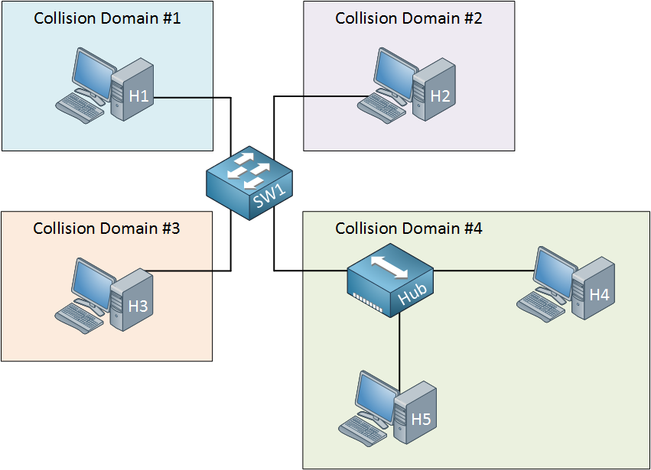
Ethernet LANs Terminology
To understand Ethernet LANs design, it is important to understand the meaning of the following LAN terms:
Collision Domains:
A network segment where collision can occur.
A network segment connected by a shared medium

Slide 87
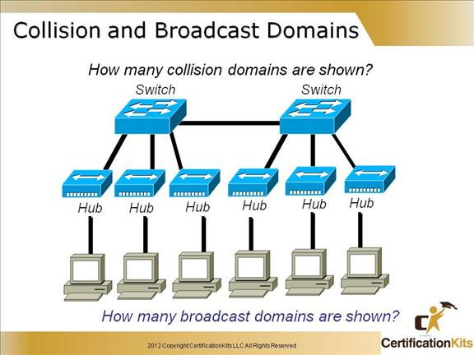
Ethernet LANs Terminology cont’d
Broadcast Domains:
Logical division of a network
A group of hosts where a frame can be flooded from a single host.
Example of Broadcast domains:

Slide 88
Switch ports
Access port: A port that belongs to one specific VLAN.
Trunk port: A port that carries multiple VLANs.
Trunk link: A trunk link is a 100 or 1000Mbps point-to-point link between two switches, between a switch and router, or between a switch and server.
It carries traffic of multiple VLANs— from 1 to 4094 at a time
VLAN Trunking Protocol: It’s a protocol that allows switches to identify which frames belong to which VLANs.

Slide 89
Switch ports cont’d
Inter-Switch Link (ISL):
This is a Cisco proprietary protocol that allows VLANs to be multiplexed over a trunk link through an external encapsulation method (ISL).
It allows the switch to identify the VLAN membership of a frame over the trunked link.
It maintains VLANs in Ethernet frames between switches and routers.

Slide 90
Ethernet LANs Terminology cont’d
Virtual LANs : VLAN
A VLAN:
is where a group of devices are part of the same broadcast domain.
Can group several broadcast domains into multiple logical subnets
A logical grouping of users by functions
Increases the number of broadcast domains while decreasing their size.

Slide 91
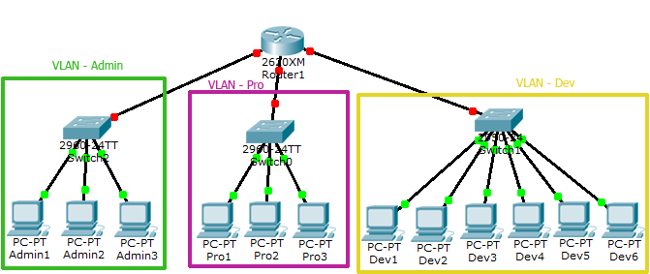
Virtual LANs : VLAN
Example of VLANs:

Slide 92
VLAN Membership
Static VLANs: They are often created by an administrator
Static VLANs are assigned to one or more switch ports
We can configure each switch port with a VLAN membership.
Dynamic VLANs: Ability of switch to automatically assign a VLAN to a port based on VLAN assignment on hardware addresses.
Dynamic VLAN makes management and configuration easier

Slide 93
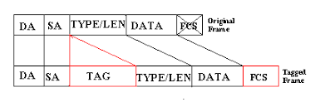
Native VLAN
By default, native VLAN is VLAN 1
The only VLAN that is not tagged in a trunk port
Native VLAN frames a transmitted unchanged
802.1Q: Is a tagging protocol that allows VLANs to communicate.
It’s also called Dot1q.

Slide 94
LAN design
LAN is composed of:
Core Switch ( Core Layer): Provides high speed rates of forwarding.
Distribution switch (Distribution Layer): Allows access switches to communicate with each other.
Access Switch ( Access Layer): It connects the end user devices.

Slide 95
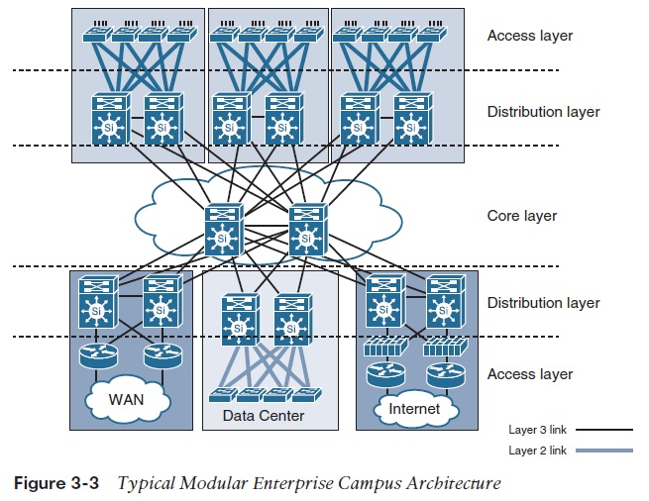
LAN design cont’d
Example of campus LAN design :

Slide 96
Review Questions
What is the result of segmenting a network with a bridge?
What is a Virtual LAN?
What is the difference between Hub, Bridge and LAN switch?
What is a collision Domain? A Broadcast Domain?
Design a campus LAN connection 2 adjacent buildings
What are the layers of a LAN switch design?

Slide 97
Cisco LAN switch configurations
Cisco offers a bunch of hardware products from switches to routers
The are equipped with LEDs that provides visual information about the switch status.
Most Cisco switches will have the following LEDs:
SYST: Status of the system
RPS: Redundant Power Supply.
STAT: Status. When it’s green, the console is on
DUPLX: Duplex
SPEED: Speed

Slide 98
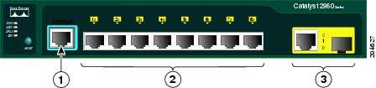
Cisco LAN switch configurations cont’d
MODE button: Check for STAT
Port/Interface: Port status.
Cisco LAN switches are equipped with an OPS called IOS which allows Network operators to interact with the device.
The IOS has an interface is called CLI or Command Line Interface.

Slide 99
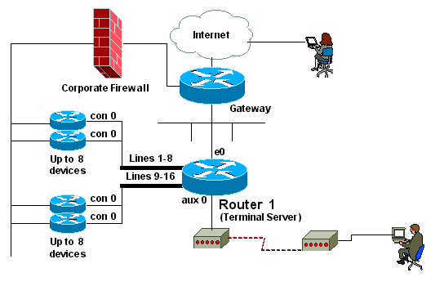
Cisco LAN switch configurations cont’d
There are three ways to access a LAN switch’s CLI:
Console
Telnet
Secure Shell (SSH) which is a protocol that provides remote access to a network device.

Slide 100
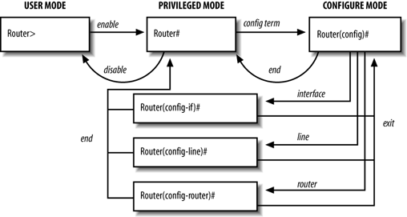
Cisco LAN switch configurations cont’d
Via CLI the operator is allowed to engage the switch IOS in two modes:
User Mode: This mode allows you to check the switch IOS without making changes.
Enable Mode: Also referred as privilege mode, or EXEC mode.

Slide 101
Cisco LAN switch configurations cont’d
Cisco switches has four types of memory/Storage.
RAM: DRAM: Dynamic Random-Access Memory. It is a working storage for the switch. Running configuration is stored in the RAM.
ROM: Read-Only Memory. It runs when the switch is powered up for the first time . ROM loads the IOS to RAM and then stops functioning.
Flash-Memory: A card that is installed in the switch for backup configurations.
NVRAM: Stores the startup configuration when the switch is reloaded.

Slide 102
Firewalls
A firewall can be either a hardware or a software on a computer.
It is a way of controlling traffic into or out of a network,
It allows traffic to exit a network, but prevents external traffic from entering the network.
Desktop firewalls: Software applications installed on a computer.
Network firewalls: Purpose-built devices that are installed at ingress and egress points of a network.

Slide 103
Review Questions
1- Define the following modes:
Configuration mode
User mode
Enable mode
2- What is the function of each LED in the LAN switch?
3- What are the four types of memory
4- What are the three ways the switch can be accessed?
5- Create a diagram showing a LAN switch connected to three PCs

Slide 104
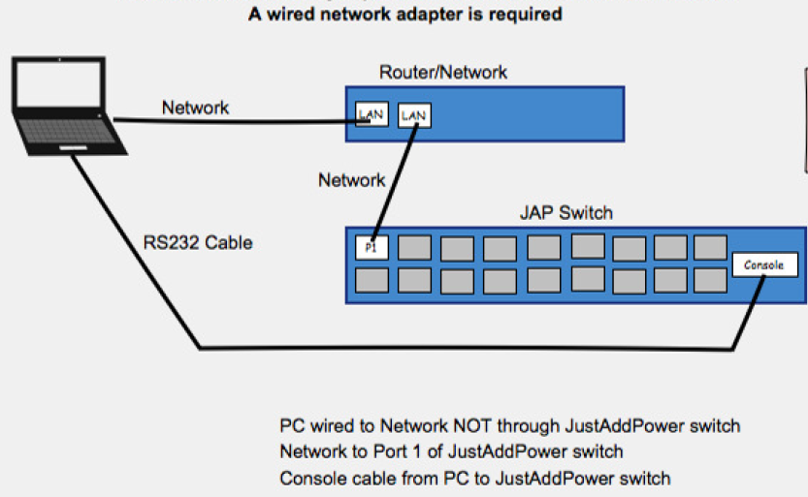
How to configure an Ethernet Switch?
For SOHO (Small Office Home Office) all LAN switches are operation and functional. ( Plug and play)
For large enterprises, it necessary to configure switches .
When configure a switch, it needs to be protected.
When configure a switch , we need to limit access to the CLI.

Slide 105
How to configure an Ethernet Switch? Cont’d
Configuring a password for Console:
Switch> enable
Switch# configure terminal
Switch (config)# enable secret cisco
Switch (config)#hostname GTPS-LAN
GTPS-LAN (config)# line console 0
GTPS-LAN (config-line)# password foodguy
GTPS-LAN (config-line)# login
GTPS-LAN (config-line)# exit.

Slide 106
How to configure an Ethernet Switch? Cont’d
Configuring a password for telnet:
Switch> enable
Switch# configure terminal
Switch (config)# enable secret cisco
Switch (config)# hostname GTPS-LAN
GTPS-LAN (config)# line vty 0 15
GTPS-LAN (config-line)# password amour
GTPS-LAN (config-line)# login
GTPS-LAN (config-line)# end.
GTPS-LAN#

Slide 107
Reducing Vulnarabilities
Improve our security consists of conducting a thorough assessment regularly
Addressing any vulnerabilities in your network
Develop a security policy.
Keep the network architecture simple.
It should be clear and understood by all to whom it applies.

Slide 108
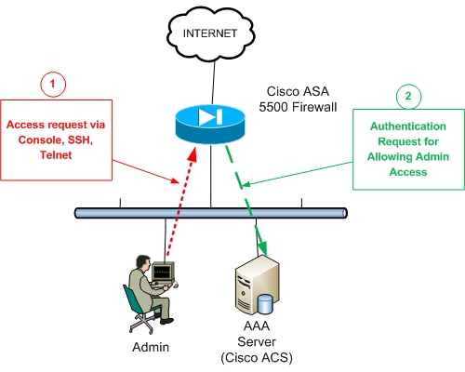
AAA Authentication Servers
AAA Overview:
Authentication, authorization and accounting (AAA) provides flexibility and modular solution for controlling access to the network.
are the framework that controls and monitors network access
Act as a central storage device to validate usernames and passwords.
The current standard by which devices communicate with an AAA server is the Remote Authentication Dial-In User Service (RADIUS).

Slide 109
The Banner Command
Banner: a message to an operator who is accessing the switch via console, Telnet or SSH.
These are texts that will appear on the screen.
Three types of banners:
Message of the day (MOTD) which is the banner text that appear before the login prompt.
Login: The banner text that is shown after the MOTD and before the login prompt
Exec: The banner text that appears after the login prompt has been provided.

Slide 110
Logging Synchronous Command
Logging Synchronous command disables the display of annoying incoming messages from the system.
This is the default settings display of all Cisco LAN switches.
Using above command will result in a more “user-friendly” user interface.

Slide 111
The Exec-Timeout Command
Exec-Timeout: Allows the network operator to have unlimited time with the switch.
It is another way to stream user interface with the switch console.
By default every LAN switch automatically removes all connections after 5 min of inactive use.

Slide 112
VLAN and IP address Configurations
Layer 2 switches only read frames for filtering
They don’t look at the Network Layer
By default switches forward all broadcasts.
VLANs create smaller broadcast domains at layer 2.
VLAN allows the network operator to create multiple IP network groups within one LAN switch.

Slide 113
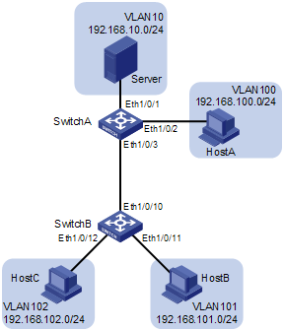
VLAN and IP address Configurations cont’d
The following diagram illustrates 2 switches with 2 VLAN interfaces each.
The switch administrator will need to activate the VLAN interface and assign the IP address to each SVI (Switched Virtual Interface)

Slide 114
VLAN and IP address Configurations cont’d
Four step process to configure VLAN Interface (SVI):
From global config mode: VLAN 10 followed by interface vlan10
Assign IP address: type in ip address mask
Type in : no shutdown
To configure a default gateway: ip default-gateway ip-address

Slide 115
Switch port configuration
GTPS-LAN# Configure terminal
GTPS-LAN(config)#interface Ethernet1/0/1
GTPS-LAN(config-if)#duplex full
GTPS-LAN(config-if)#speed 100
GTPS-LAN(config-if)#description server connection
GTPS-LAN(config-if)#exit
GTPS-LAN(config)#exit
GTPS-LAN#Show interfaces status

Slide 116
Switch LAN port security
Many ways to activate security in individual ports:
Each port can be assign a maximum number of MAC address.
Each port can be configured with a list of MAC address.
We can define an authorized list of devices.

Slide 117
Review Questions
What is the process of configuring a LAN switch via Telnet?
Describe the process of creating a password for a LAN switch
What is the process of configuring a LAN switch via console?
What is the process of configuring a switch interface?
How many ways a port can be secured in a LAN switch?
What are the steps tp assign an IP address to an interface ?

Slide 118
IPv4 Sub-netting
Sub-netting:
Allows engineers to apportion IP addresses for more efficient use.
Its purpose is to maximize the ability of a single network to carry multiple groups of IP addresses.
Sub-netting prevents wasting IP address space.
Example:
If an Engineer is given a Class B address for network of 10 devices, the waste of address space is incredible

Slide 119
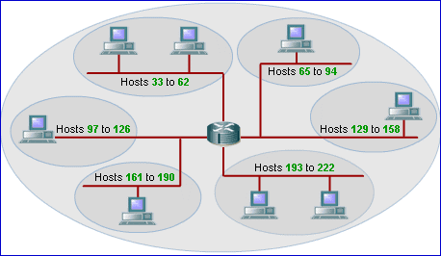
IPv4 Sub-netting cont’d
This diagram below shows an example of subnetting:
** Sub-netting is short for subdivided network.

Slide 120
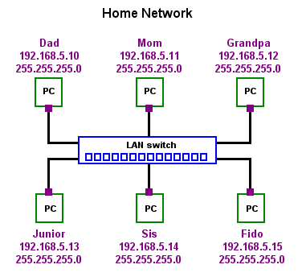
IPv4 Sub-netting cont’d
All networking devices require an IP address.
An IP address identifies a device on a network.
The IP address allows frames to be delivered to any device.

Slide 121
IPv4 Sub-netting cont’d
Subnet Mask:
A subnet mask is 32-bit binary number
A subnet mask contains two fields:
Network field
Host field
It indicates the range of addresses in use on a particular network.
Subnet Mask is used to determine how addresses are subnetted.
Each Class has a default subnet mask associated with it:
Class A 255.0.0.0
Class B 255.255.0.0
Class C 255.255.255.0

Slide 122
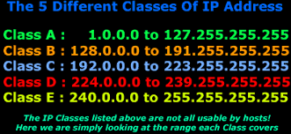
IPv4 Network Classes
IPv4 has 5 classes of addresses:
Class | First Octet Values | Purpose
A | 1-126 | Unicast (large networks)
B | 128-191 | Unicast (medium-sized networks)
C | 192-223 | Unicast (small networks)
D | 224-239 | Multicast
E | 240-255 | Experimental

Slide 123
IPv4 Network Classes
IPv4 has 5 Classes A, B, C, D and E
The first 3 can be assigned to a host or a device
Classes A, B and C contain unicast addresses
Class D contains multicast addresses
Class E are reserved for specific requirements.
The first octets are universal values
They identify the Class of each IPv4 network.

Slide 124
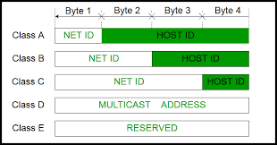
Network and Host IDs concept cont’d

Slide 125
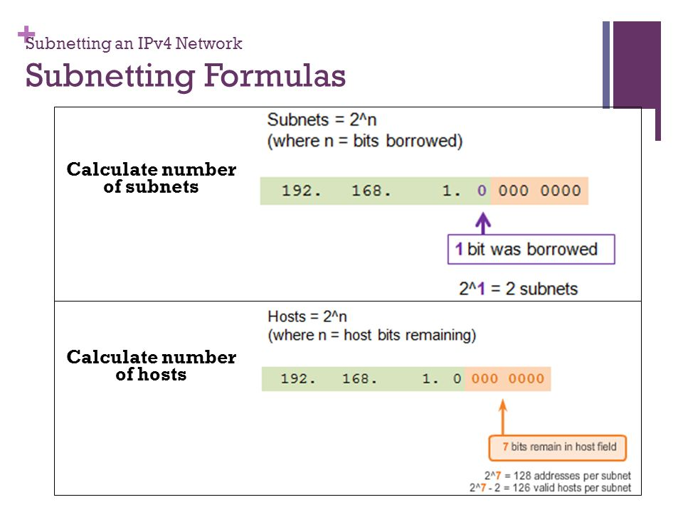
IPv4 Network Classes- Subnetting formulas

Slide 126
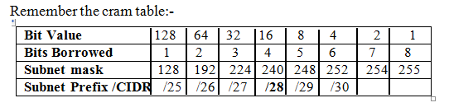
IPv4 Network Classes cont’d

Slide 127
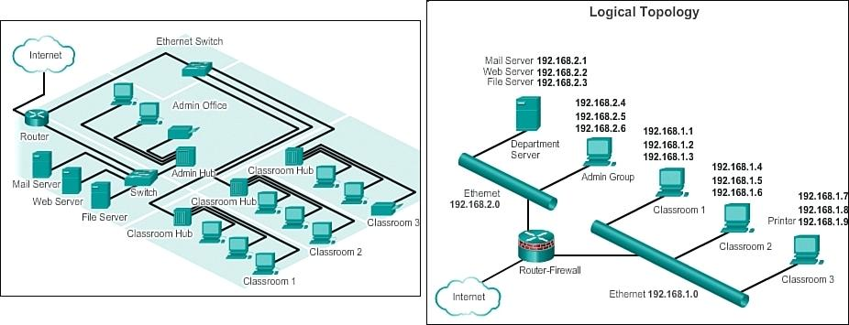
Calculate the subnets number
A sample network layout will help you calculate how many subnets do you need.

Slide 128
Addressing requirements
Developing an IP addressing plan requires the following:
Determine what your needs are.
Identify and list each subnet.
Determine the proper range of IP addresses for each subnet.
How to derive the correct mask and address combination to support the number of devices.

Slide 129
Review your internetwork design
If it’s a newly designed LAN:
Check the design specifications.
Check the business plan.
Check the staffing number for each site.
Check the number of devices ordered for each site.
If it’s an existing LAN ( i.e already in ops):
Study the existing LAN
Determine their host assignments for each site.

Slide 130
Making a network design choice
The requirements to making a design choice are the following:
1- Choosing the Network:
Company’s internetwork
Number of hosts expected
Expansion plans in the future
2- Choosing the Mask that defines the IP address range needed.
3- Build the Subnet list
Subnet number or subnet ID
Subnet Broadcast or broadcast address

Slide 131
Private IP Addresses
These addresses are used on private network.
These addresses are not routable through the Internet.
It creates a measure of much needed security.
It saves valuable IP address space.
Companies use private IP addresses on their inside networks.

Slide 132
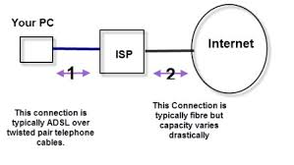
Public IP Network
A public IP address is the Internet which was overrun by requests for public IP addresses.
Companies are assigned each unique Public IP addresses.
Public IP address space was exhausted due to so many requests.
ISPs were not able to assign public IP networks with unique IP addresses.

Slide 133
Internet community solutions:
Three solutions to address the exhaustion of public address space:
Network Address Translation (NAT)
IPv6 which is an extension version of IPv4
Subnetting public IP networks.
NAT:
Is designed for IP address conversion.
It allows a company’s IP address structure to appear differently to outside networks.
It translate the private addresses to a public address.

Slide 134
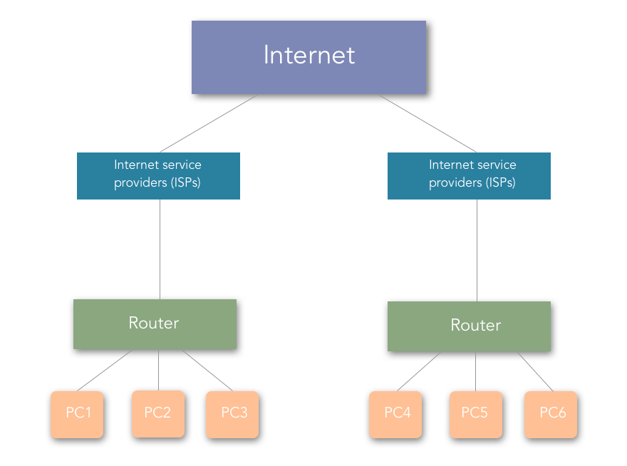
Internet community solutions cont’d
NAT allows the same public IP network to be assigned to different companies
Same IP networks have same IP addresses that both companies can use.

Slide 135
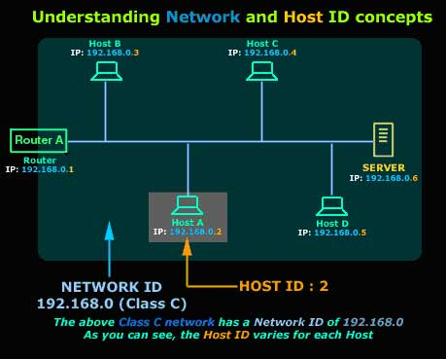
Network and Host IDs concept:

Slide 136
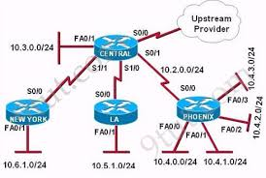
Design Implementation
Implementing the design consists of the following:
Identify the location (site)
Assign IP addresses to devices that require static IP
Configure the DHCP server with the chosen IP range.

Slide 137
Review Questions
Define NAT. Detail how it works
What are the rules for choosing a mask?
What is the process of creating a subnet?
Define a subnet.
Define an IP address
Provide a diagram showing a subnet design plan
What is a public IP network?
What is a private IP network?
Identify a Class A, B and C IP address and their default mask.

Slide 138
Review Questions cont’d
Determine the number of Network octets.
What are the differences between the 5 Classes of IPv4?
Total number of IP networks for Class C?
What is a subnet?
Define a subnet ID and a subnet broadcast address.
Identify the subnet ID of 172.16.128.0
What is a unicast?
What is a multicast?
What is the multicast range of IP addresses?

Slide 139
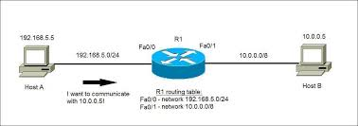
IPv4 Implementation-Configurations
Routers:
Routers connect networks and route packets between networks.
By default, routers break up a broadcast domain.
A broadcast domain is a set of all devices on a network segment.

Slide 140
Enterprise Router installation
Steps for Enterprise router installation:
Connect LAN cables to LAN ports
Connect the leased line to the CSU/DSU in the router.(Serial interface)
Connect the router console port to the computer.
Connect the router power cable
Power on the router.

Slide 141
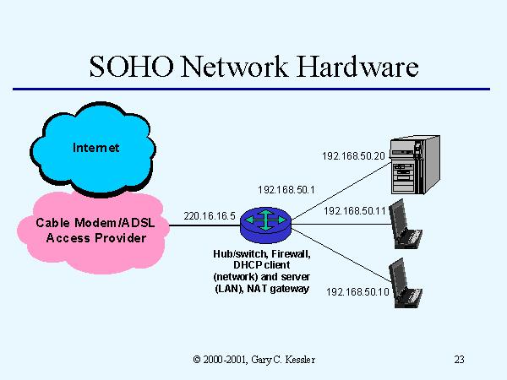
SOHO Router installation
SOHO uses cable modem to connect to ISPs.
SOHO networks use routers that are integrated with LAN devices.
Cable modem is like CSU/DSU in an Enterprise network.

Slide 142
SOHO Router installation
Steps for SOHO router installation:
Router and LAN switch have to be connected to each other with a straight-through UTP cable.
The router needs to be connected to the cable modem.
Connect the laptops to the LAN switch.
Connect the power cable to a power outlet.
Connect the router to the power
Power on the router

Slide 143
Review Questions
Define a CSU/DSU
Create a SOHO diagram
What are the PIN OUTs to connect CSU/DSU to leased line?
What is a router? What does it do?
Create a basic Enterprise diagram.
What does DSL stand for ?
What is a cable modem?

Slide 144
IP routing
A set of protocols that determines the path of the data flow.
Routing is taking packet from one device to another
Routers don’t care about hosts.
They only care about networks and the best path to each.
In dynamic routing, routers communicate with each other via the same protocol running on each of them.
Routers update each other via the same protocol if a chance occurs on the network.

Slide 145
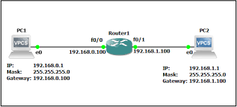
Route Processing Methods
Process switching:
The host sends an IP packet to the router
Router checks the IP subnet and IP address in the packet.
Router checks its routing table
It encapsulates the data with HDLC.
It then sends out the packet to the destination.

Slide 146
Route Processing Methods cont’d
Fast Switching Method:
It keeps a list more recently used IP addresses.
It keeps a copy of the data link header on all IP packet.
It allows router IP addresses faster
Fast Switching is a more optimized version of the process switching.
**HDLC: High-Level Data Link Controller. It’s a Cisco proprietary protocol used to send data over serial links.

Slide 147
Route Processing Methods cont’d
Cisco Express Forwarding (CEF) Method:
It optimized the routing process method.
Like fast switching, it copies header of the IP packets
It increases the packet switching speed.
It has a few more optimization features:
An more organized set of routing tables
It has a very sophisticated algorithm
It takes less time to do its work.

Slide 148
Routing Basics
The term routing is used for taking packets from one device to another.
Routers use the routing tables in the following ways:
Connected Routes: IP networks that are directly connected to a router’s interface.
Routers add these routes to its routing table.
Static Routes: When you manually add routes in the router’s routing table.
Dynamic Routes: It is when protocols are used to find and update routing tables on routers.

Slide 149
IPv6
Intended to replace IPv4
Increases IP Address size
Unlike IPv4 , it doesn’t suffer from lack hierarchical structure.
Improves scalability and multicast routing
Simplifies host addressing.
Simplifies auto-configuration of addresses.
Has better performance

Slide 150
IPv6 cont’d
With its 32 bit address format, IPv4 can provide a maximum of 4.3 billion of unique IP addresses.
With its 128 bit address format, IPv6 can support 3.4 x10 power 38 unique IP addresses.
With IPv6, NAT is not needed because the address space is large enough.
IPv6 is logically divided into a Network prefix and a host identifier.
IPv6 addresses are classified as unicast, multicast, or anycast addresses.
It uses 128-bit format that consists of an eight-part hex address separated by colons. (:)

Slide 151
IPv6 cont’d
There are eight 16-bit hex values separated by colons.
X:X:X:X:X:X:X:X
Therefore an IPv6 address is expressed as follows:
ADBF:0:FEEA:0:0:00EA:00AC:DEED or
ADBF:0000:FEEA:0000:0000:00EA:00AC:DEED
IPv6 offers two methods for compressing the syntax of the address space:
1- The first is the omission of the leading zeroes
2- The 2nd is the replacement of multiple groups of zeroes by double colons (::)

Slide 152
IPv6 cont’d
First method: ADBF:0:FEEA:0:0:EA:AC:DEED
2nd method: ADBF:0:FEEA::EA:AC:DEED
The double colon can appear only once in the address.
All IPv6 addresses will display as compressed.
The CLI accept both compressed and uncompressed addresses
Here is another Example:
2001:0000:ABCD:EF22:0000:1234:5678:0001
2001::ABCD:EF22:0:1234:5678:1

Slide 153
IPv6 types of addresses
IPv6 supports the following types of addresses:
Unicast and Multicast addresses.
Unicast Address: Unicast address represents an end node or host.
Unicast Address use continuous bits to represent the subnet mask.
In IPv6, there are several types of unicast addresses:
Global
Link-Local
Unique-Local
Anycast address

Slide 154
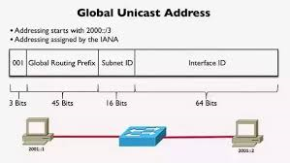
Global address
Global Unicast Address has a predefined prefix of 2000::/3.
It consists 48-bit global routing prefix.
It contains 16-bit subnet ID that can be used to create local addressing
It contains 64-bit called “Extended Unit Identifier” (EUI) used for generic IPv6 communication.

Slide 155
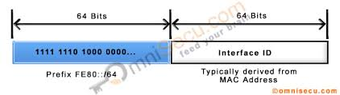
Link-Local
Link-Local is used on single link.
It’s significant on the physical medium connected to a router.
Only host and router interconnection are aware of the Link-Local address for that segment.
Routers don’t advertise Link-Local addresses.

Slide 156
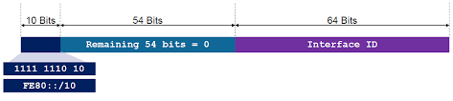
Link-Local cont’d
Link-Local has the following features:
It’s automatically assigned when enable IPv6
It’s used for next-hop calculation in routing decision.
The first 10-bit of the prefix are always 1111 1110 10 (FE80::/64)
The last 54-bit can be zero or any configured value

Slide 157

Unique Local
Unique local address is used for inter-site VPNs and local communication within an organization.
Unique local addresses are not routable on the internet.
Its first 7-bits of prefix are 1111 110 (FC00::/7)

Slide 158
Anycast Address
An address that is assigned to more than one interface
When a packet sent to an Anycast address, routing dictates which member of the group receives the packet closest to the source.
**ACE(Cisco Application Control Engine) does not support Anycast for IPv6.

Slide 159

Multicast Address
A multicast address is identified by eight 1 bits at the start of the IPv6 address.
Has a predefined prefix of FF00::/8 (1111 1111).
It’s an identifier for a set of interfaces that belong to different nodes.

Slide 160
Configuring IPv6 Addressing
The 1rst step is to make sure the current IOS is at least 12.2(1)T
AT least each interface has to be configured with an IPv6 link-local address
2nd step is to enable IPv6 globally on the router.
Router-ipv6# configure terminal
Router-ipv6(config)# ipv6 unicast-routing.

Slide 161
Configuring IPv6 LAN Addresses
Each interface has to be configured with an IPv6 link-local address.
Then add a site-local and global address to the interface.
Global and site-local are assigned at the same time.
If only the first 64 bits are specified, the EUI command of the global address will have an Interface ID assigned to it.
Configure IPv6 on each interface.

Slide 162
Configuring IPv6 LAN Addresses cont’d
1. Configure router for predetermined global address:
Router-ipv6# configure terminal
Router-ipv6(config)# int e0
Router-ipv6(config-if)# ipv6 address 2000:1:1::1/64
Router-ipv6(config-if)#
2. Configure router for global address to be assigned Interface ID:
Router-ipv6(config)# int e0
Router-ipv6(config-if)# ipv6 address 2000:1:1::1/64 eui-64
Router-ipv6(config-if)#

Slide 163
Configuring IPv6 LAN Addresses cont’d
When the EUI parameter is used, the remaining 64 bits are automatically completed by the router.
**The link-local address has the same last 64 bits as the global address.
If no other IPv6 address will be assigned to the interface and only need to configure a link-local address, the option to manually define the link-local address is there:
Router-ipv6(config-if)# ipv6 address fe80::1:1:1:1 link-local
The following command will enable the ipv6 on the interface and will automatically generate the link-local address using the modified EUI-64 interface ID based on the interface MAC address
Router-ipv6(config-if)# ipv6 enable

Slide 164
Stateless autoconfiguration
Configuring IPv6 addresses based on prefixes received in router advertisement message consists to configuring stateless auto configuration on the interface.
A link-local address is also automatically configured when auto config is enabled.
Router-ipv6(config-if)# ipv6 autoconfig

Slide 165
Infrastructure services
DNS
DHCP
NTP
ACLs
NAT

Slide 166

DNS
Domain Name System: DNS is the Internet's system for converting hostnames IP addresses.
It makes navigating this complex IP network a user-friendly.

Slide 167
DHCP
Dynamic Host Configuration Protocol:
A network management protocol that conveys IP assignment and Network parameters information.
It provides quick , automatic and central IP management within a network.
It can be defined also as a network service that enables computers to be automatically assigned settings from a server as .

Slide 168

Network Time Protocol
NTP: A network protocol used to synchronize time of different devices to an accuracy of one nanosecond.
It’s a connectionless protocol (UDP)
It automatically searches for best time sources to synchronize.

Slide 169
Access Control list
ACL is a filter that allows network operator to control the flow of data within a network.
ACL can control access to networks by permitting or denying particular traffic.
ACL can limit the content of routing updates
ACL can secure devices by limiting access to services such as SNMP
ACL is comprised of a sequential series of filters defined globally on the router

Slide 170

ACL example
Access-list 1 permit 192.168.10.20
Access-list 1 permit 10.12.1.25
Access-list 1 deny 192.168.10.16
There is an implicit deny all command at the end of every ACL.
Any packet that has no match in the ACL rules is dropped.
Access-list 1 permit any.

Slide 171
Review Questions
What is CEF?
Define Fast Switching
What is IP route?
Define a static route.
What is Process Switching.
What does a router do when receives an IP packet?
What is a routing table?
Which device uses routing table to make a forwarding decision?

